Slide 1
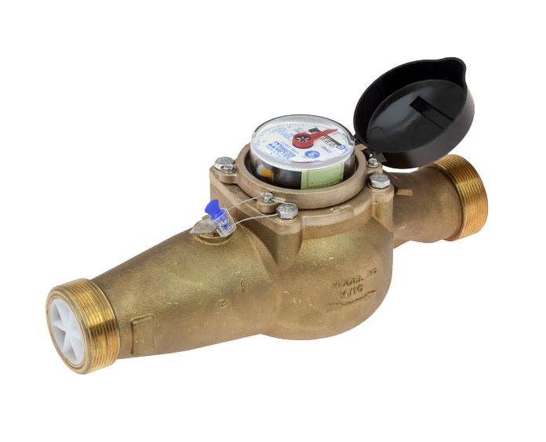

CSU Hydraulics Lab

Slide 2

Van Brewster

Slide 3

Thompson #1

Slide 4

Loveland

Slide 5

Green Ridge Glade Reservoir

